Slide 1
On RTG Design
Alexander Hoppe and Taylor Sheneman

Slide 2
Our System

Slide 3
How little plutonium can we use for a given power and mission length?

Slide 4
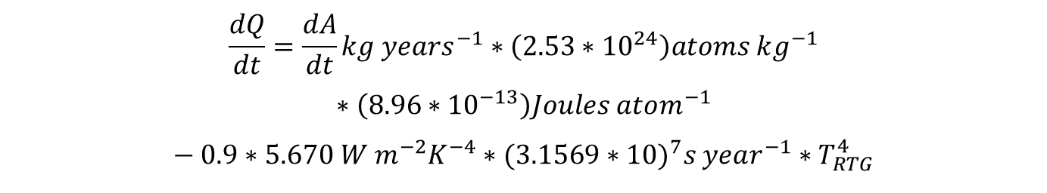
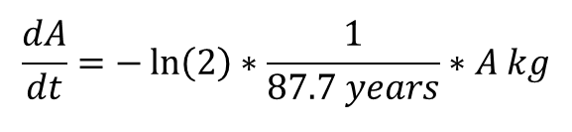
Our Model
$$\frac{dQ}{dt}=\frac{dA}{dt}kg years^{−1}∗\left(2.53∗{10}^{24}\right)atoms kg^{−1}$$
$$∗\left(8.96∗{10}^{−13}\right)Joules atom^{−1}$$
$$− 0.9∗5.670 W m^{−2}K^{−4}∗(3.1569∗{10)}^{7}s year^{−1}∗T_{RTG}^{4}$$
$$\frac{dA}{dt}=−\ln\left(2\right)∗\frac{1}{87.7 years}∗A kg$$

Slide 5
Our Results
Power Threshold = 100W

Slide 6
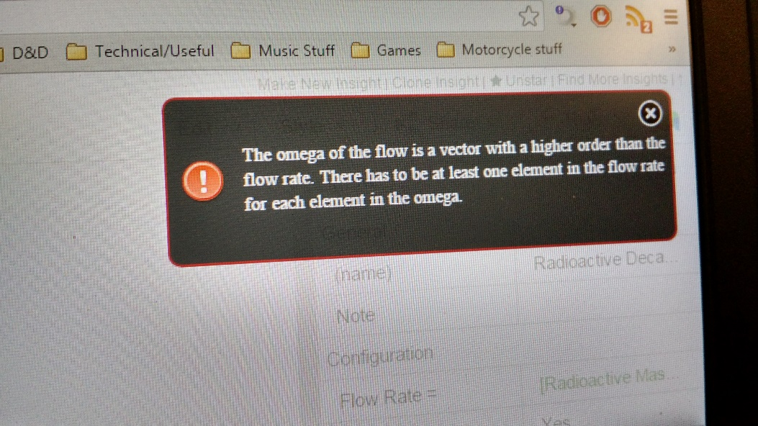
Our Failures
Silliness
MATLAB: “No params defined. Perhaps Java isn’t running?”
Insight Maker: “Are you dividing by zero?”

Slide 7
Our Takeaways

Slide 8
Our Design Recommendation
Probe to Alpha Centauri B Orbit: 105 years
Mandated Power Threshold: 240W
Minimum Pu-238:

